Slide 1


Slide 2




Reference books
UML 2.0 in Action by Patrick Graessle
Systems Analysis and Design with UML 3rd Edition by Alan Dennis
UML Distilled, 3rd Edition by Martin Flower
Visual Modeling with Rational Rose by Terry Quatranie
Unified Software Development by Booch, Rambaugh, Jacobson

Slide 3

Course Catalogue - HEC
 Object-Oriented Analysis: Developing the Static Model, Class Diagrams, UML Relationships: Association, Aggregation, Composition, Inheritance. UML Packages, Object Diagrams.
Object-Oriented Analysis: Developing the Dynamic Model ,Use Case Diagrams, Sequence Diagrams, Collaboration Diagrams, Statechart Diagrams, Advanced States: Substates, Superstates,Activity Diagrams.

Slide 4

Course Goals
 After successful completion of this course students should be able to do analysis of software system. Do modeling using UML and create diagram like use cases, activity, class, sequence, collaboration etc.

Slide 5


Slide 6





What is Systems Analysis and Design?
 Systems are created to :
solve problems.
Think of the systems approach
an organized way of dealing with a problem.
System Analysis and Design, mainly deals with
the software development activities.

Slide 7


Defining A System
A collection of components that work together to realize some objective forms a system.
Basically there are three major components in every system, namely input, processing and output.

Slide 8




System Development Life Cycle
organizational
 System Development Life Cycle is an process of
developing and maintaining systems.
System development life cycle means combination of various activities .
Following are the different ^{phases} of software development cycle:
System study
Feasibility study
System analysis
System design
Coding
Testing
Implementation
Maintenance

Slide 9

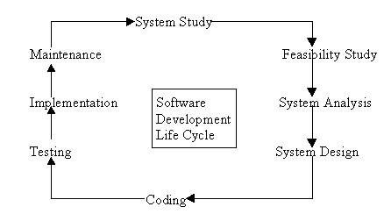
System Development Life Cycle

Slide 10

System Environments ?
Development
Test
Staging
Pre-Production
Production
Mirror
Roles involved:
 D, DM, PM, TM, CM & DT.

Slide 11

System Study
System study - 1st stage of system development life cycle.
Gives clear picture of what actually the physical system is.
System study phases (I & II):
I: initial survey of the system - helps in identifying the scope.
II: in-depth study - requirement identification / limitations & issues of current system.
Proposal:
Prepared after completing the system study,
prepared by the System Analyst.
Contains the findings of the current system
Recommendations to overcome the limitations / issues of the
current system.
Steps of System study phase:
problem identification and project initiation.
background analysis.
inference or findings.

Slide 12

Feasibility Study
Done on the basis of initial study.
It is the test of the proposed system in the light of its workability, user’s requirements, effective use of resources and the cost effectiveness.
Goal : to achieve the scope.(not to solve issues)
Advantage: Cost and benefits are estimated with greater accuracy.

Slide 13

System Analysis
Analysis is detailed study of :
current system, leading to specifications of a new system.
system operations & its relationships within & outside system.
Data collection for: files, decision points, & transactions of present system.
Tools of system analysis: Interviews, on-site observation & questionnaire.
Steps to define boundary of the new system:
Keeping in view the problems and new requirements
Workout pros & cons including new system
Analysis is documented in: detailed DFDs, data dictionary, logical data structures & miniature specifications.
Includes sub-dividing of complex process, data store identification & manual processes.

Slide 14

System Analysis Action items
Specification of what the new system is to accomplish based on the user requirements.
Functional hierarchy showing the functions to be performed by the new system and their relationship with each other.
Function network which are similar to function hierarchy but they highlight the those functions which are common to more than one procedure.
List of attributes of the entities - these are the data items which need to be held about each entity (record)

Slide 15




System Design
 Based on the and the detailed
user requirements
analysis
of a new system, the new system must
be designed.
 This is the phase of system designing. It is a
most crucial
phase in the development of a
system.
Normally, the design proceeds in two stages :
Preliminary or general design
Structure or Detailed design

Slide 16

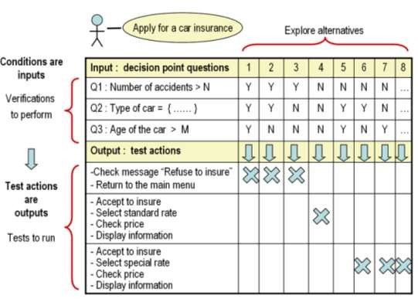
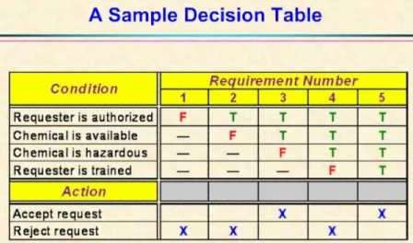
 There are several tools and techniques used for designing. These tools and techniques are:
Flowcharts
Data flow diagrams (D
Data dictionary
Structured English
Decision trees
FDs
)

Slide 17




Coding
Coding the new system into computer programming language
converts human instructions into a format that computer understands.
Coding is stage where defined procedure are transformed into control specifications by the help of a computer language.
This is also called the programming phase in which the programmer converts the program specifications into computer instructions, which we refer as programs.
The programs coordinate the ^{data movements}_ and control the entire process in a system.
modular
 It is generally felt that the programs must be in nature. This
helps in fast development, maintenance and future change, if required.

Slide 18

Testing
Removing all the bugs, if any - Before implementing
Test plan is developed and run on given set of test data.
Output of test run should match expected results.
Using test data following test runs are carried out:
Unit test: After coding / compiling programs, they are individually tested with test data. Any ambiguity must be noted & debugged.
System Test: done after unit test. Complete system is executed on actual data. Results or output of system is analyzed. If output is not matched with expected outputs, errors are identified and are fixed.

Slide 19

Implementation
After UAT, the implementation phase begins.
It is the stage during which theory is turned into
practice.
All programs of the system are loaded onto the user's computer.
After loading the system, training of the users starts.
Main topics of such type of training are:
How to execute the package
How to enter the data
How to process the data (processing details)
How to take out the reports
After the users are trained about the computerized system, manual working has to shift from manual to computerized working.

Slide 20

System Run Strategies:
Parallel run: computerized & manual systems are executed in parallel. Advantages of Parallel run:
Manual results comparison with the computerized one.
Failure of the computerized system at the early stage, does not affect the working of the organization.
Pilot run: New system is installed in parts. Some part of the new system is installed first and executed successfully for considerable time period. Advantages:
When results are found satisfactory then only other parts are implemented.
This strategy builds the confidence and the errors are traced easily.

Slide 21

Maintenance
Maintenance is required to:
eliminate errors in the system during its working life
tune the system to any variations in its working
environment.
Errors are always in system that must be corrected.
System Review: is necessary from time to time for:
knowing the full capabilities of the system
knowing the required changes or the additional requirements
studying the performance
Major change during the review:
If a major change to a system is needed, a new project may have to be set up to carry out the change.
New project will then proceed through all above life cycle phases.

Slide 22


learning Objectives
Describe and Understand Structured analysis and design
Describe and Understand Object-Oriented
analysis and design
Distinguish between structured analysis and design and object-oriented analysis and design

Slide 23

Introduction
SAD (Structured analysis) is a traditional systems development technique that is time-tested and easy to understand.
Structured analysis uses a set of process models to describe a system graphically.
Because it focuses on processes that transform data into information, structured analysis is called a process- centered technique
Whereas structured analysis treats processes and data as separate components, object-oriented analysis combines data and the processes that act on the data into things called objects.
System analysts use O-O to model real world business
processes and operation.
The result is a set of software objects that represent actual people, things, transactions and events

Slide 24

Systems Development Methodologies
 Structured analysis and design
 “Structured analysis is a set of techniques and graphical tools that allow the analyst to develop a new kind of system specification that are easily understandable to the user. Analysts work primarily with their wits, pencil and paper.” [Kendall 1996]

Slide 25

Systems Development Methodologies
Structured analysis and design
Developed in the late 1970s by DeMarco, Yourdon, and Constantine after the emergence of structured programming.
In 1989, Yourdon published “Modern Structured
Analysis”.
The availability of CASE tools in the 1990s enabled analysts to develop and modify the graphical SAD models.
Philosophy of structured analysis and design
Analysts attempt to divide large, complex problems into
smaller, more easily handled ones. “Divide and Conquer”
Top-Down approach
Functional view of the problem.
Analysts use graphics to illustrate their ideas whenever
possible
Goals of SAD
Improve Quality and reduce the risk of system failure
Establish concrete requirements specifications and complete requirements documentation
Focus on Reliability, Flexibility, and Maintainability of system

Slide 26

Systems Development Methodologies
Structured analysis and design
Elements of Structured Analysis and Design
Essential Model: Model of what system must do.
Does not define how the system will accomplish its purpose.
Is a combination of the environmental and
behavioral model
Environmental Model
Defines the scope of the proposed system.
Defines the boundary and interaction between the system
and the outside world.
Composed of: Statement of Purpose, Context Diagram, and Event List.

Slide 27

Systems Development Methodologies
Structured analysis and design
Behavioral Model
Model of the internal behavior and data entities of the system.
Models the functional requirements.
Composed of Data Dictionary, Data Flow Diagram, Entity Relationship Diagram, Process Specification, and State Transition Diagram.

Slide 28

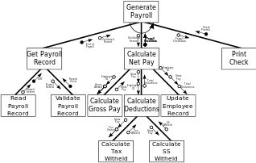
Systems Development Methodologies
Structured analysis and design
Implementation Model
Maps the functional requirements to the hardware and software.
Determines which functions should be manual and which should be automated.
Defines the Human-Computer Interface.
Defines non-functional requirements.
Tool: Structure Charts

Slide 29

Systems Development Methodologies
Structured analysis and design
Advantages of Structured analysis and design
visual, so it is easier for users/programmers to understand
Makes good use of graphical tools
A mature technique
Process-oriented approach is a natural way of thinking
Flexible
simple and easy to understand and impalement

Slide 30
Systems Development Methodologies
Structured analysis and design
Disadvantages of Structured analysis and design
Not enough user-analyst interaction
It depends on dividing system to sub systems but it is to
decide when to stop decomposing

Slide 31

Systems Development Methodologies
Object-Oriented analysis and design
Object-Oriented analysis and design becoming popular because of its ability to thoroughly represent complex relationships, as well as represent data and data processing with a consistent notation
Object-Oriented analysis and design blend analysis and design in evolutionary process
It allows you to deal with the complexity inherent in a real-world problem by focusing on the essential and interesting features of an application

Slide 32

Systems Development Methodologies
Object-Oriented analysis and design
Process of progressively developing representation of a system component (or object) through the phases of analysis, design and implementation
The model is abstract in the early stages
As the model evolves, it becomes more and more detailed

Slide 33

Systems Development Methodologies
Object-Oriented analysis and design
Object-Oriented systems development life cycle
The Object-Oriented development life cycle consists of progressively developing an object representation through three phases analysis, design, and implementation
Analysis Phase
Object-oriented analysis is a popular approach that sees a system from the viewpoint of the objects themselves as they function and interact
Model of the real-world application is developed showing its important properties
Model specifies the functional behavior of the system independent of implementation details

Slide 34

Systems Development
Methodologies
Object-Oriented analysis and design
Design Phase
Analysis model is refined and adapted to the environment
Can be separated into two stages
System design
Concerned with overall system architecture
Object design
Implementation details are added to system design
Implementation Phase
Design is implemented using a programming language or
database management system

Slide 35

Systems Development Methodologies
Structured analysis and design vs. object oriented analysis and design
Similarities
Both SAD and OOAD had started off from
programming techniques
Both techniques use graphical design and graphical tools to analyze and model the requirements.
Both techniques provide a systematic step-by-step process for developers
Both techniques focus on documentation of the requirements

Slide 36

Systems Development Methodologies
Structured analysis and design vs. object oriented analysis and design
Differences
SAD is Process-Oriented
OOAD combines data and the processes
OOAD encapsulates as much of the systems' data and processes into objects, while SAD separates between them

Slide 37

Summary
Structured analysis treats data and processes as separate components
The Environmental Model:
Statement of Purpose, Context Diagram, and Event List
T he Behavioural Model:
Data Flow Diagram, Process Specification, Data Dictionary, and Entity-Relationship Diagram
The Implementation Model:
Structure Diagram
Object-oriented (O-O) analysis, combines data and processes into objects. The Object-Oriented development life cycle consists of progressively developing an object representation through three phases analysis, design, and implementation

Slide 38

Summary
In this Sequence we have
Defined structured analysis and design
Explained the philosophy of structured analysis and design
Described the goals of structured analysis and design
Discussed the elements of structured analysis and design
explained the advantages and disadvantages of
structured analysis and design
Describe and Understand Object-Oriented analysis and design
Explained Object-Oriented systems development life cycle
Distinguish between structured analysis and design and object-oriented analysis and design

